Slide 1





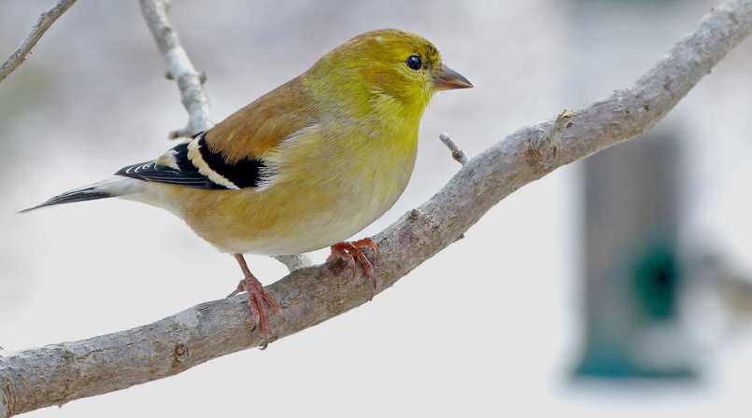

American Goldfinch
by Bob Vuxinic

Slide 2
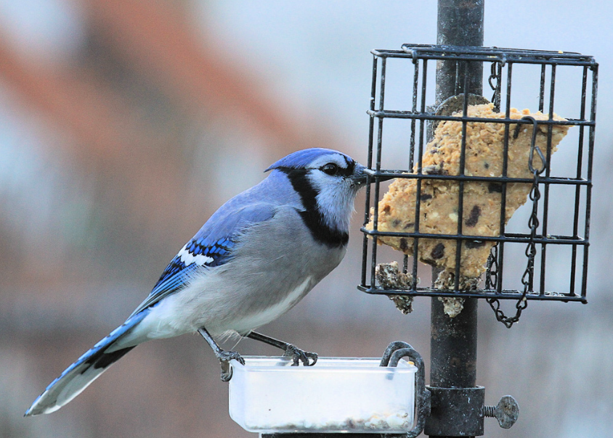
What is Project FeederWatch?
Anyone who feeds birds can participate
Repeated counts November – April
Maximum number of each species
Provides presence and
absence data
Behavioral Interactions
Blue Jay by
Maria Corcacas

Slide 3
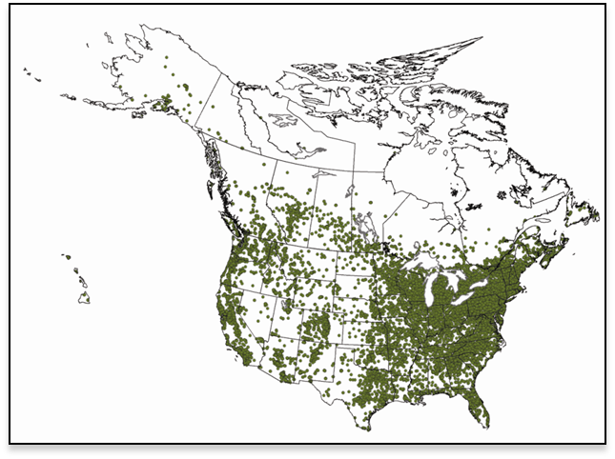
The Numbers
20,000 participants / year
52,000 count sites
100 million birds reported
4.2 million hours of volunteer time
2 books, 26+ scientific papers
Started in 1977 by Bird Studies Canada
Cornell Lab of Ornithology joined in 1987
Fully funded by participant fees and gifts

Slide 4
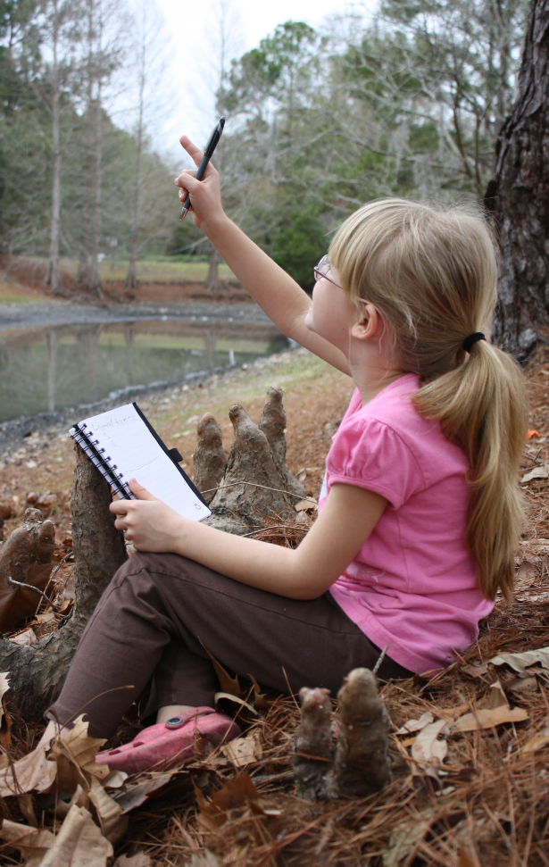
FeederWatch is Citizen Science
What is Citizen Science?
Involves the public in scientific research
Answers large-scale & longitudinal questions
Promotes environmental awareness &
scientific literacy
Your observations are important!
Amanda Boyarshinov

Slide 5
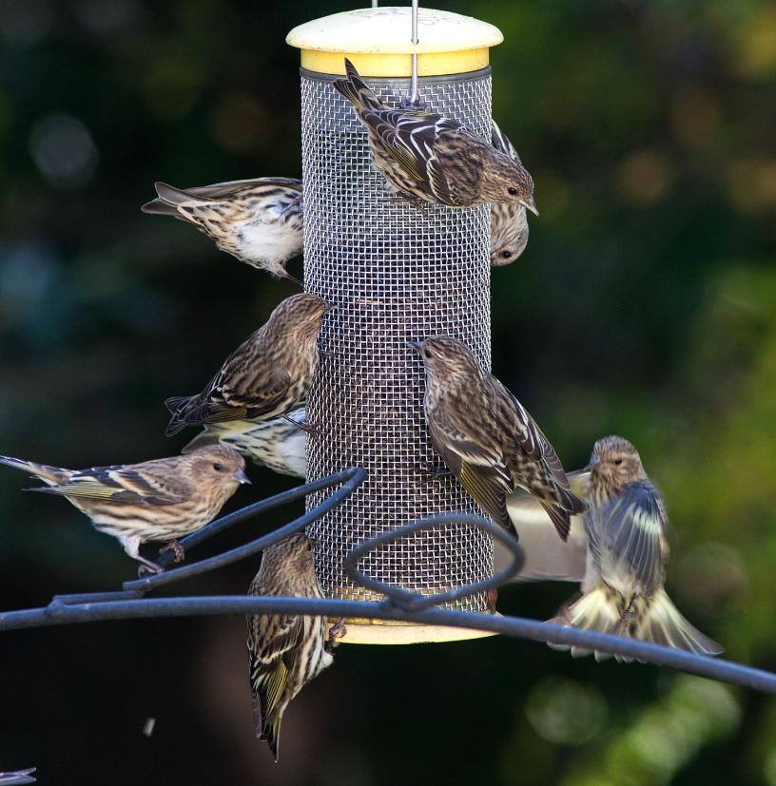
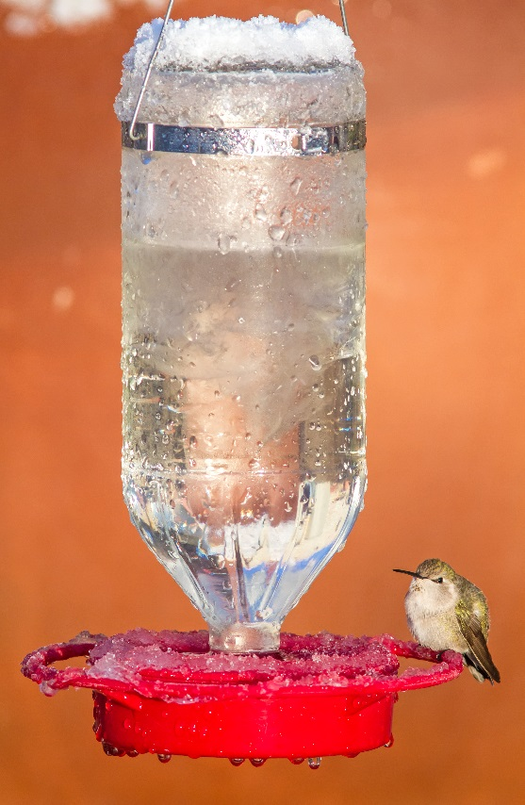
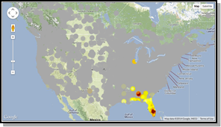
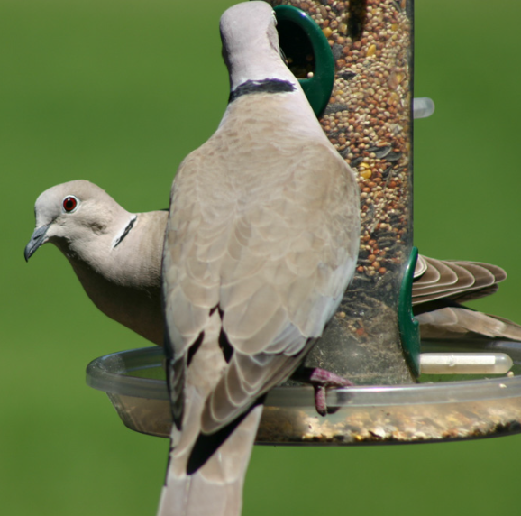
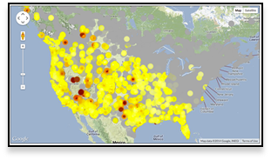
FeederWatch Data is used to…
Understand shifting bird populations
Follow winter range expansions or contractions
Record irruptions for winter finches and other species
Track the spread of non-native species
Monitor disease outbreaks
And much more!
Pine Siskin irruption by Paul Smith
Anna’s Hummingbirds expand
winter range by Susan Beebe
Eurasian Collard-Doves spread across North America by Kevin Carver

Slide 6
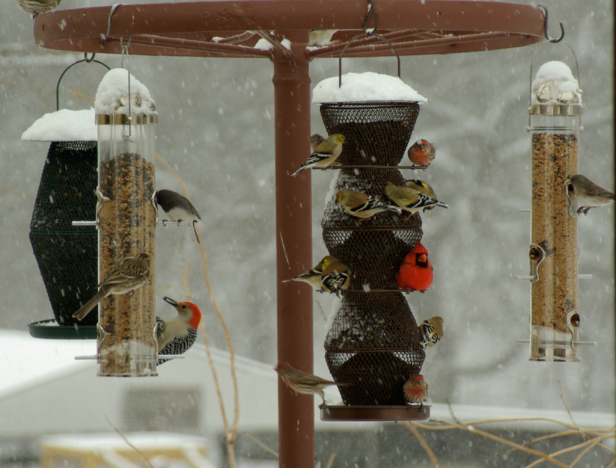
How to FeederWatch
Set up a count site - ACL Main Children’s Courtyard Bird Feeding Stations & Gardens
Choose count days - Fridays & Saturdays
Count your birds - Retrieve Tally Sheet from display
Record behaviors - (Optional)
Submit data – Turn in at Youth Services Desk
Mixed species by Marquita Seifried

Slide 7
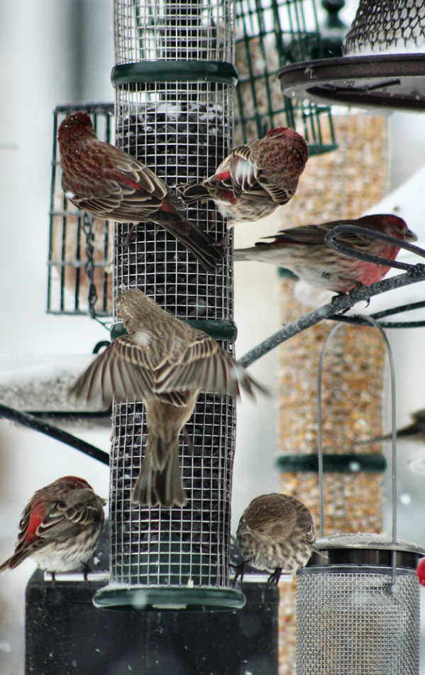
Count Your Birds
What should I count?
All of the individuals of each species in view at any one time
Birds attracted to food or water you provided
Birds attracted to fruits or plantings
Birds attracted to the activity around your feeders, including predatory birds and tag-a-long birds, even if the birds don’t come to your feeders or plantings themselves
House Finches by Maria Corcacas

Slide 8
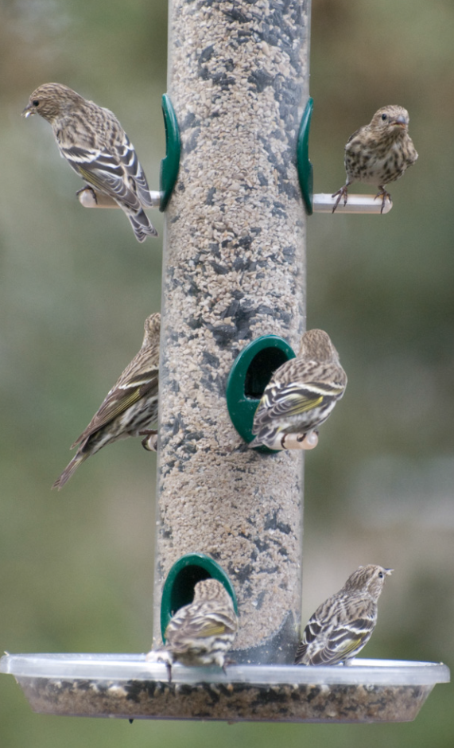
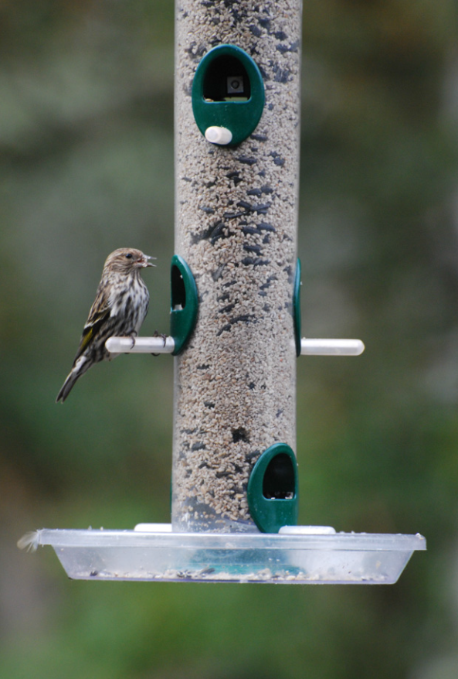
How to count
Day 1: Record the
maximum number of
each species seen
simultaneously.
Day 2: Repeat!
Your final count is the largest number for each species over both days.
Day 1 = 1
Day 2 = 6
Tally= 6
Pine Siskins by Brandon Green

Slide 9
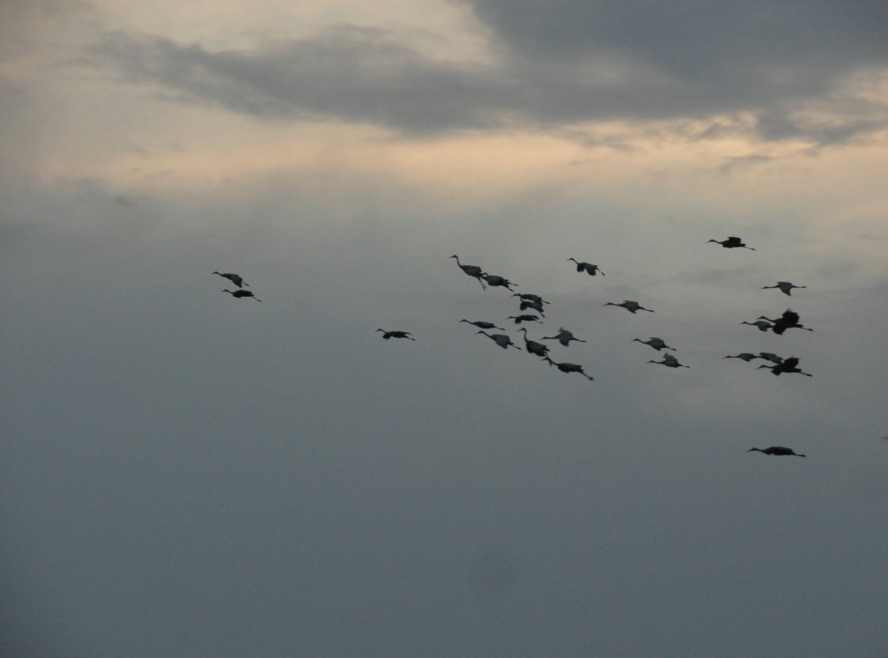
Don’t Count
Birds that fly over the count site
Birds seen on non-count days (Sundays through Thursdays)
Sandhill Cranes by Diana Adams

Slide 10
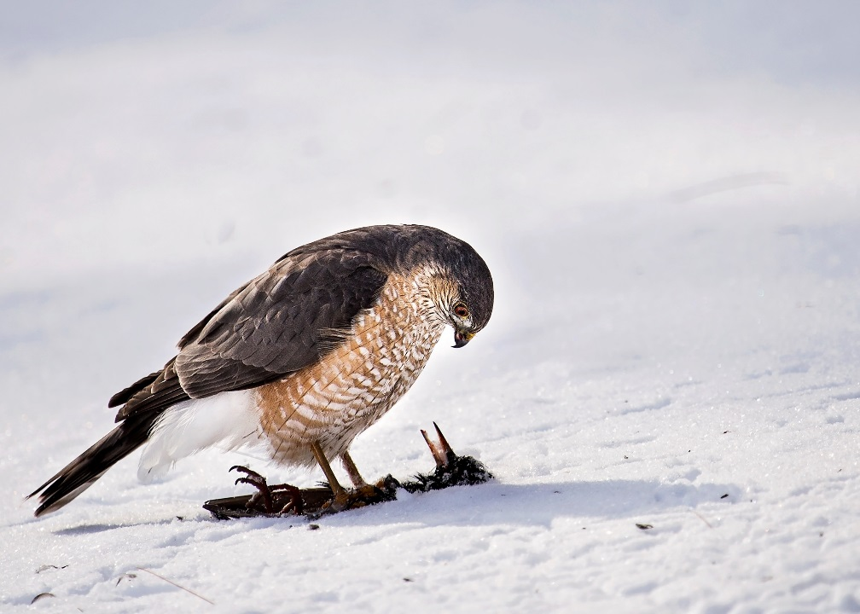
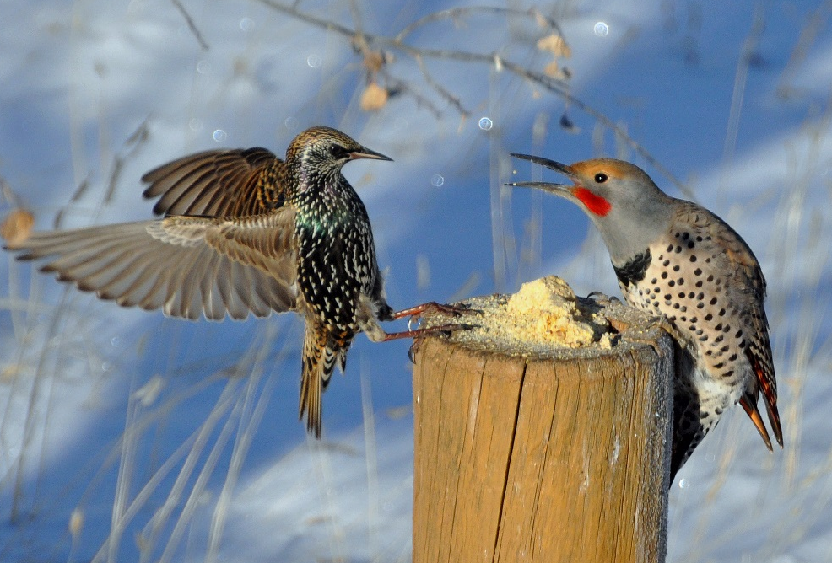
Behavioral Interactions
Record both successful and
unsuccessful interactions!
  Displacement = When one bird (the “source”) tries to take over a resource-food or a perch occupied by another bird (the “target”).
Predation = When one bird (the “source”) attempts to capture or kill another bird (the “target”).
Northern Flicker (source) displaces European Starling (target). Photo by Pam Koch.
Sharp-shinned Hawk (source) depredates European Starling (target). Photo by Karen Burke.

Slide 11
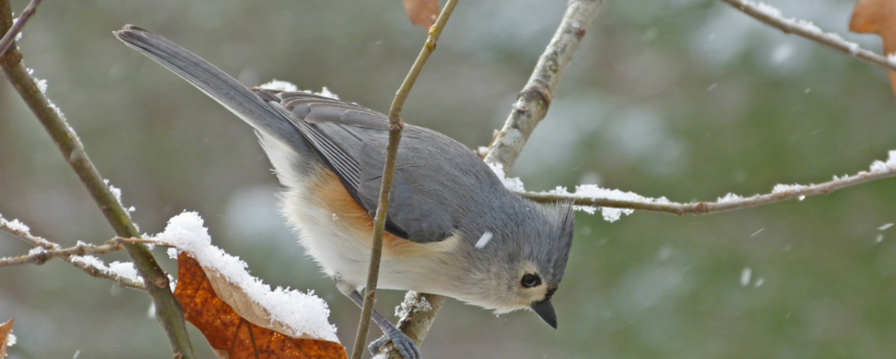
Record Weather & Time
What was the weather like during your count days?
How much time did you spend watching your site?
Tufted Titmouse by Bob Vuxinic

Slide 12
Enhance Your Experience
Digital Resources:
  Cornell Lab of Ornithology website
  Merlin smartphone App (Cornell Lab)
  eBird (Cornell Lab)
  iNaturalist smartphone App (Natl. Geo. & CA Ac. of Sci.)
  Discus website (SC State Library)
  eBooks & Audiobooks (ACL Overdrive, Libby & Hoopla)
  Greenville County Bird Club website & Facebook page- Upstate Bird Forum
Print Resources:
  Birds of The Carolinas Field Guide (Stan Tekiela)
  Peterson Field Guide to Birds of North America (Roger Tory Peterson)
  Birds of the Carolinas (Potter, Parnell & Teulings)
  Sibley Birds East (David Allen Sibley)
  Look Up! Bird-Watching in Your Own Backyard (Annette LeBlanc Cate)
  Backyard Birds of Winter (Carol Lerner)
  About Birds: A Guide for Children (Cathryn Sill)
  Backyard Birds: An Introduction (Robert Bateman)
  *AND many more available from ACL!

Slide 13
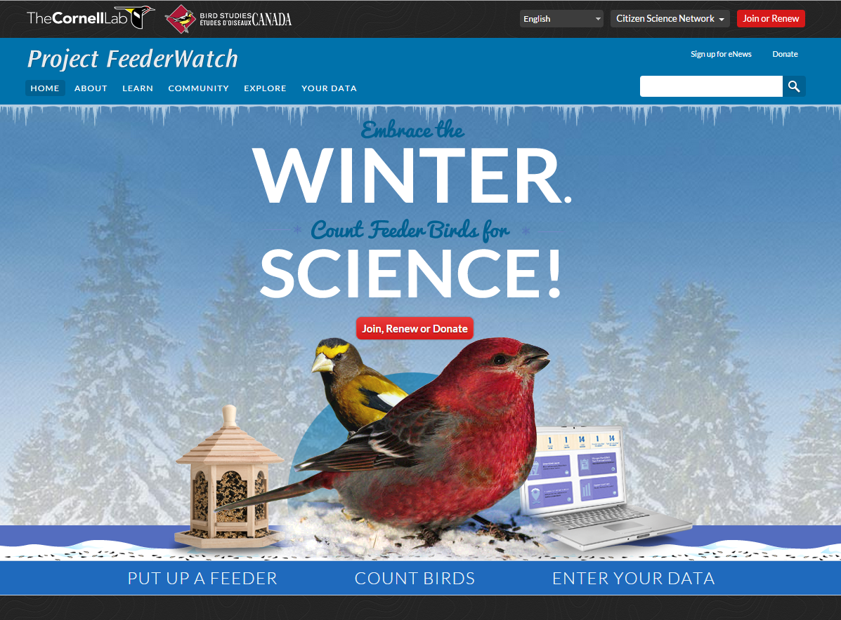
Get Involved!
Visit us on a Friday or Saturday between Nov. 14th – Apr. 9th
Pick up a Tally Sheet with instructions from our display or desk.
Choose an available field guide from our display; use our Common Feeder Birds Poster; or use a free smart phone app such as Merlin.
Choose a spot at our courtyard windows, or on a courtyard bench to wait and watch quietly, and as motionless as possible.
Please be courteous and considerate of other bird watchers and remain physically distanced.

