Slide 1
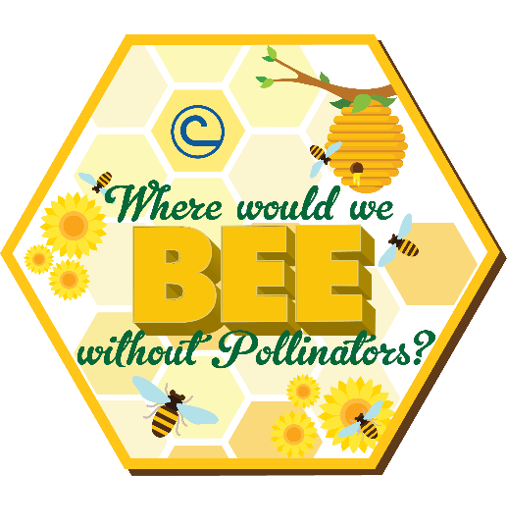

2020 NACD Stewardship Week
April 26 – May 3
Where Would We BEE Without Pollinators?
Notes:
2020 NACD Stewardship Week
April 26 – May 3
Where Would We Bee Without Pollinators?
Your local conservation district (to find visit https://www.nacdnet.org/general-resources/conservation-district-directory/)

Slide 2
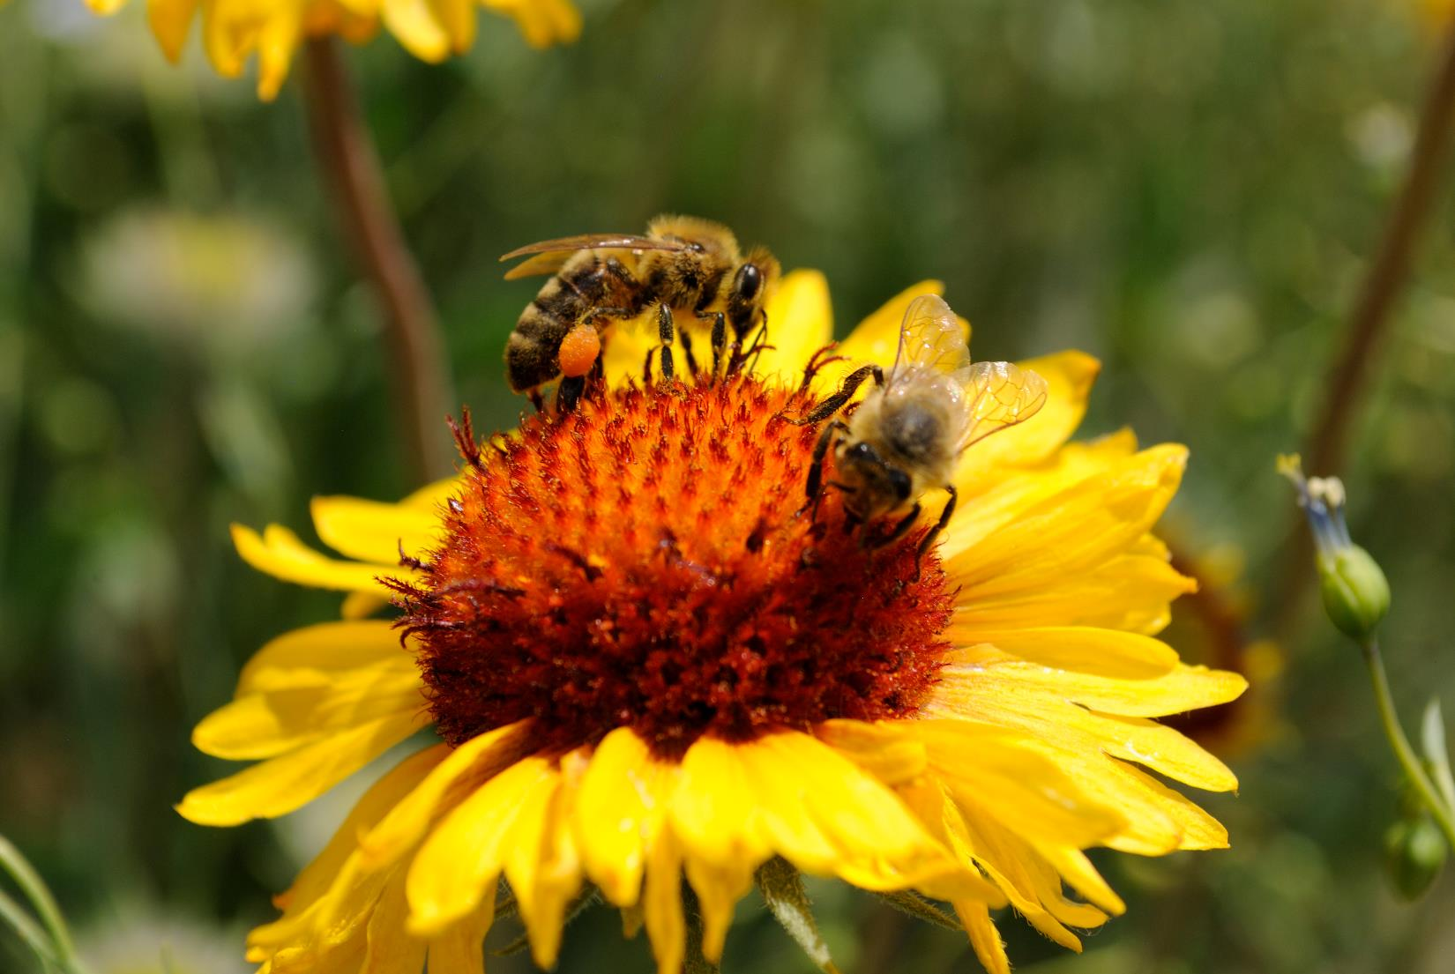
The importance of pollination
Who are pollinators?
How are they threatened?
Notes:
Overview of this module: the importance of pollination, who are the pollinators, and how are they threatened?

Slide 3
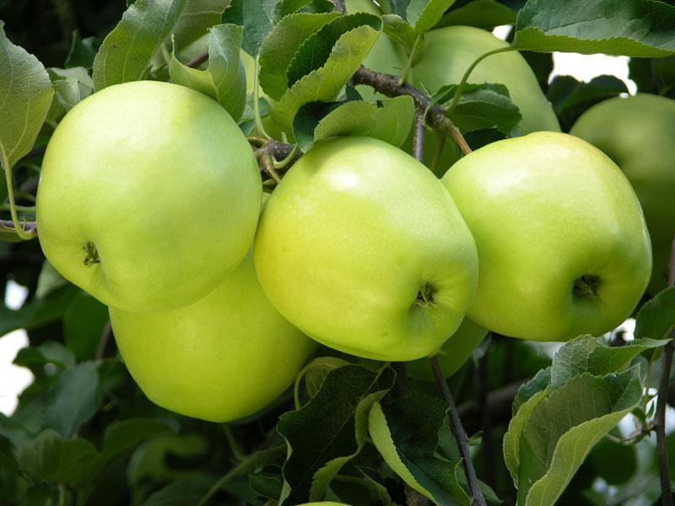
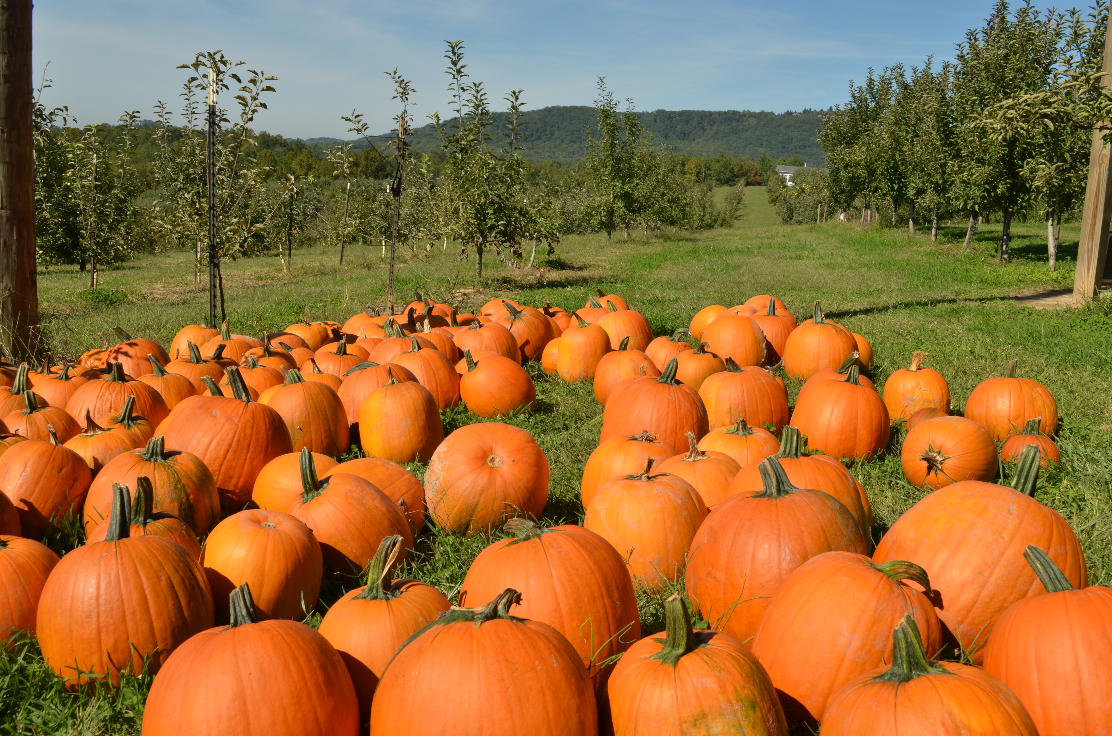
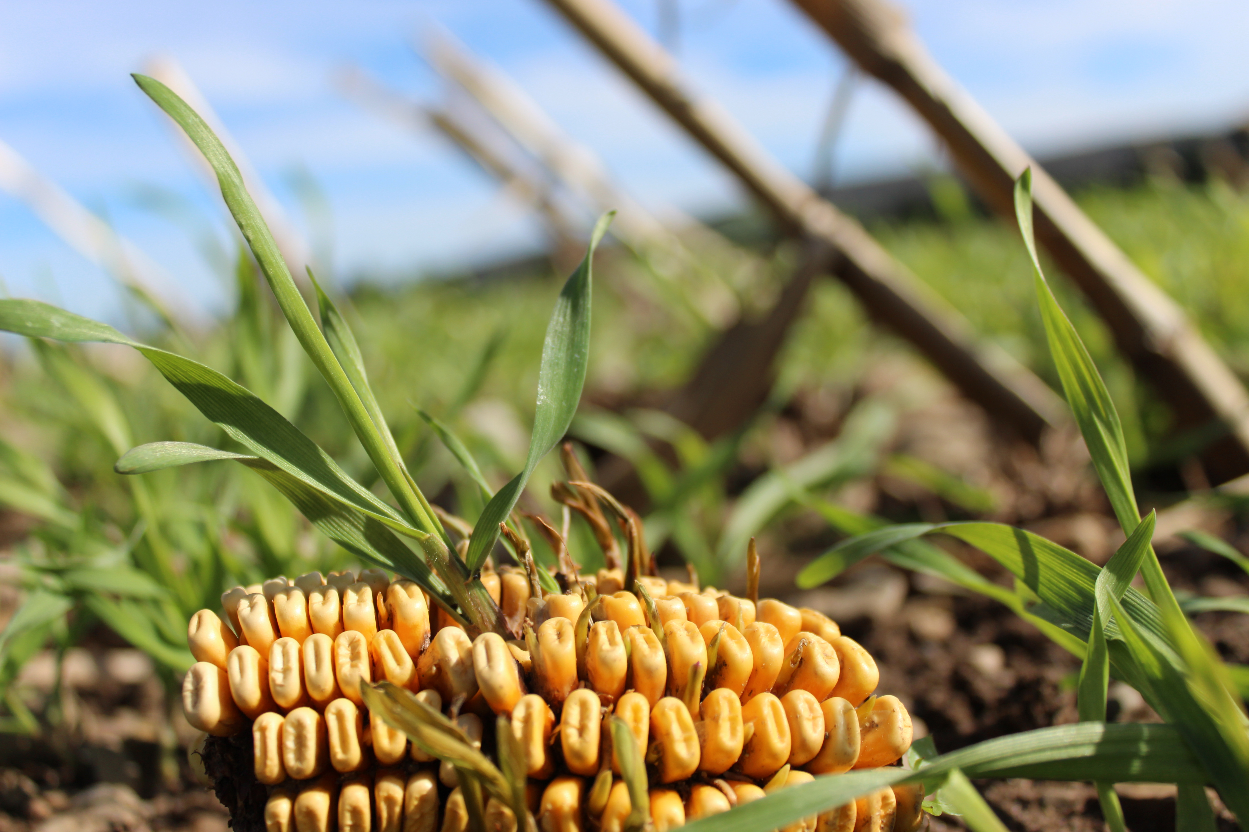
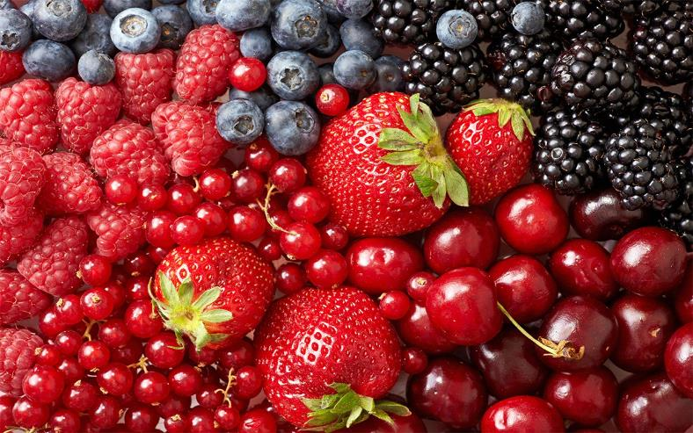
One in Every Three Bites
Notes:
We can thank pollinators for one in three mouthfuls of food and drink – everything from coffee and chocolate to most fruits and many vegetables in our diet. Pollination is also critical for many of the animal products we consume, including dairy products, beef, pork and poultry. These animals consume insect-pollinated legumes such as alfalfa and clover at some time during their growth. When we start to think about what we ate yesterday for breakfast, lunch, and dinner, we start to understand the importance of pollinators in our own diets.

Slide 4
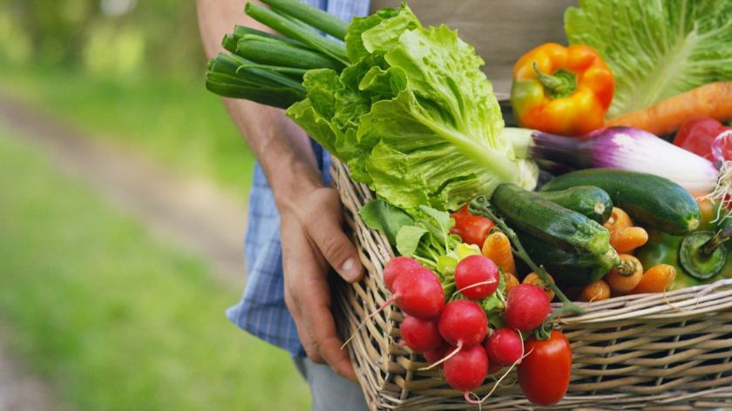
The Food
We Eat
Pollinators:
Provide an ecosystem service that enables plants to produce fruits and seeds
Affect 35% of global agricultural land, supporting the production of 87 of the leading food crops worldwide.
Affect crops that are valued at over $24 billion in U.S. ($277 – 577 billion worldwide)
Notes:
FAO, The importance of bees and other pollinators for food and agriculture, 20 May 2018
http://www.fao.org/3/i9527en/i9527en.pdf
Xcerces Society, Economic Impact, 2016
https://xerces.org/2016/06/09/the-value-of-protecting-pollinators/

Slide 5
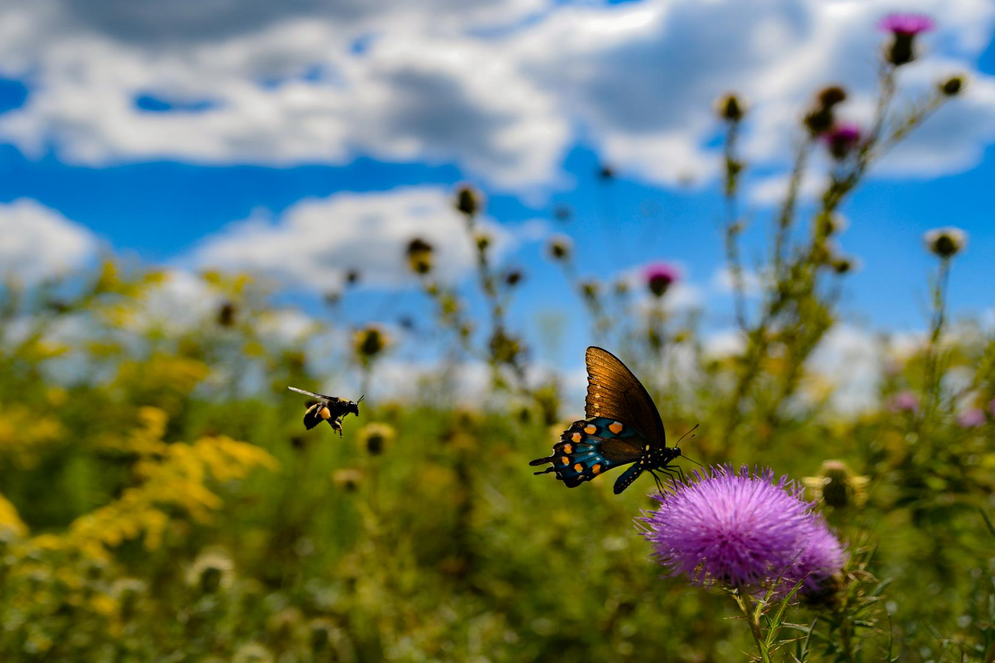
Annual Value of Insect Pollinated Crops
Alfalfa (seed and forage) - $7 billion
Apple – Over $1.5 billion
Almond – Over $ 1.1 billion
Berries – Over $ 2.5 billion
Canola, soybean and cotton
Notes:
The annual income from pollinated crops in the US is quite astounding. Over $12.1 billion per year and that does not include other crops like citrus, cranberries, blueberries, etc.
Both canola and soybeans will self-pollinate, but production is improved with pollination by bees.
Almonds are an interesting crop example. The California almond industry depends almost completely on the pollination services of migratory honey bee hives. An estimated 1.6 million hives are brought into almond orchards for pollination each spring when the almonds are in bloom. California’s Central Valley produces almost two-thirds of the world’s almond harvest, an estimated two billion pounds per year.

Slide 6
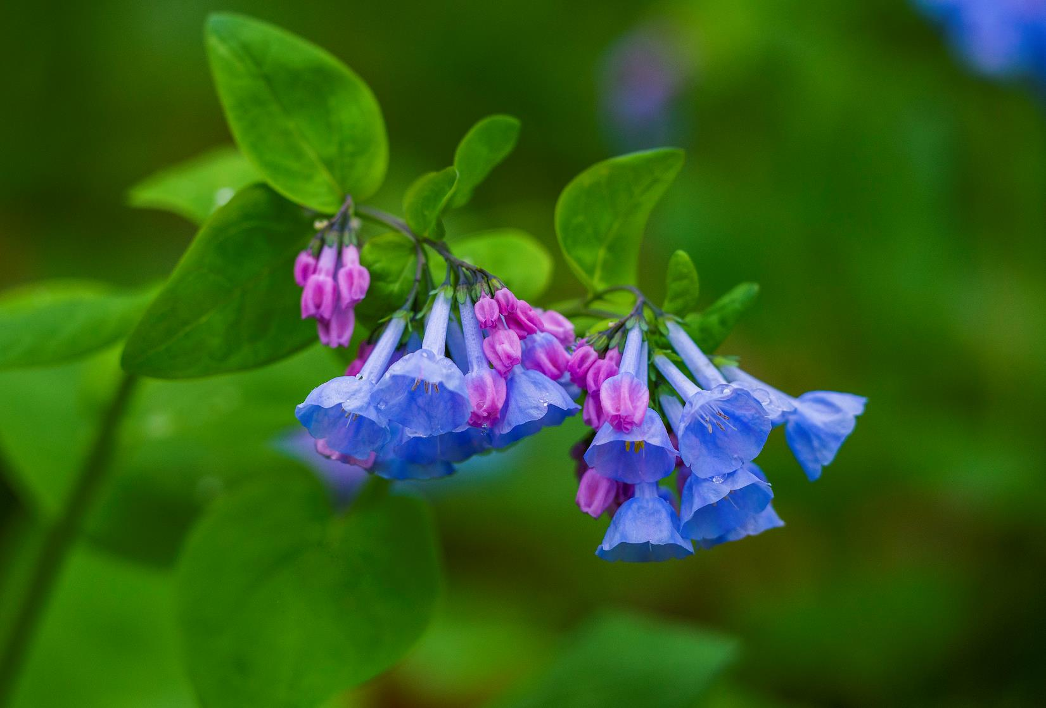
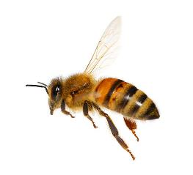
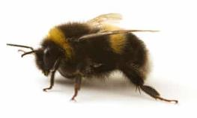
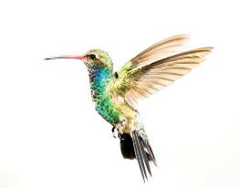
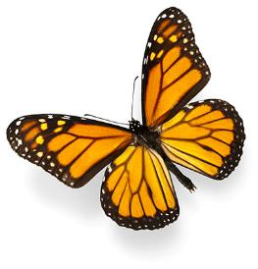
Native Plants Need Pollinators
Notes:
Some plants, like this Virginia bluebell, can benefit from the pollination services of several different pollinators.
“Virginia bluebell flowers are pollinated by long-tongued bees primarily, including honeybees, bumblebees, Anthophorid bees, Mason bees, large Leaf-Cutting bees, and Miner bees; these insects seek nectar and collect pollen. Other visitors of the flowers include hummingbirds, bee flies, butterflies, skippers, and Sphinx moths, including hummingbird moths. This group of visitors seek nectar from the flowers. Small flower flies may also visit the flowers, however they feed on the pollen and are not effective pollinators.” Source: http://www.illinoiswildflowers.info/woodland/plants/bluebells.htm)

Slide 7
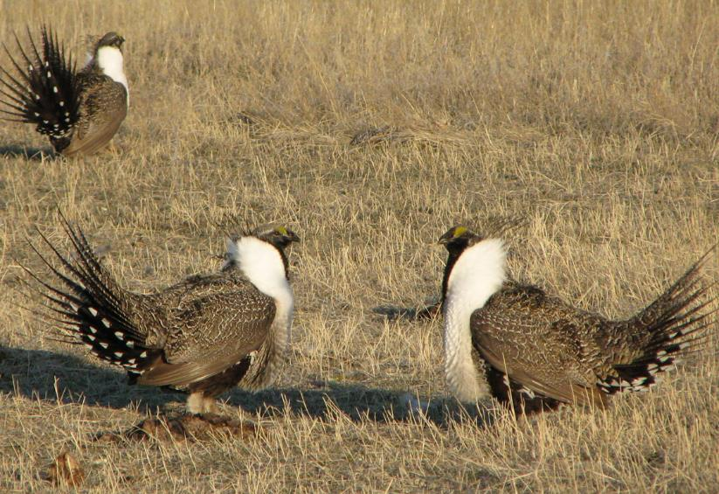
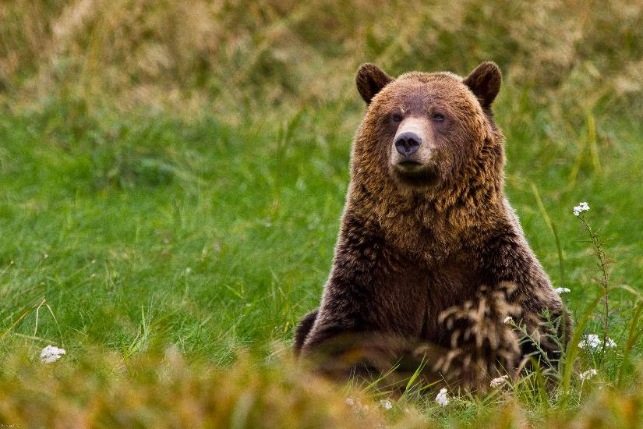
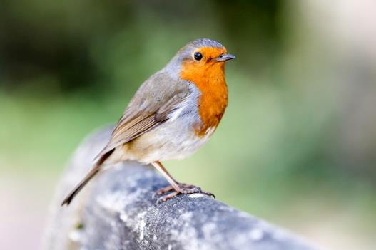
Wildlife Food web
Fruits and seeds are a major part of the diet of about 25 percent of birds and many mammals.
Pollinators are food for wildlife.
Notes:
This slide illustrates that pollinators are not only essential for plant reproduction, but their pollination work provides food for many other birds and mammals. Pollinators also make up a portion of the diet of a variety of other animals.
“Fruits and seeds derived from insect pollination are a major part of the diet of approximately 25 percent of all birds, and of mammals ranging from voles to bears to humans.” (https://oregonforests.org/sites/default/files/2018-04/WIMF_data_Pollinators_web.pdf)
Pollinators are important in a grizzly bear’s diet. This is due, in part, to the richness of their diet, which in Yellowstone consists mostly of white bark pine nuts, as well as roots, tubers, grasses, various rodents, emerging army cutworm moths and scavenged carcasses.

Slide 8
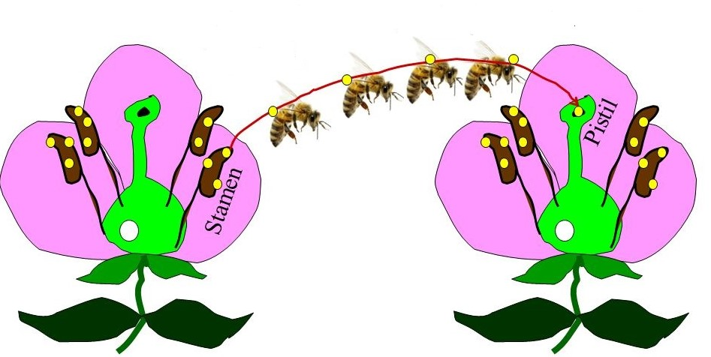
What is Pollination?
Notes:
** NOTE** Modify the information below for AGE appropriate presentation
Pollination is the transfer of pollen from anthers to stigma. Most plants need pollen from a different plant of the same species for fertilization to take place.
Pollination can be abiotic or biotic. Abiotic pollination involves a non-living agent to transfer pollen, such as wind or water. Biotic pollination involves a living being transferring pollen from flower to flower.
Flowers can perform two functions: signal and reward. The signal (color, scent, pattern) lets the pollinator know that the flower has food. The reward for the pollinator can be nectar, pollen or both.
Pollen is produced in the slipper-like anthers of the male stamens. The female portion of the flower, the pistil, consists of the stigma, the style and the ovary. The pollen must be transferred from the anther to the stigma. The pollen grows from the stigma, down the style and to the ovules.
Pollination is different from fertilization. Pollination is only the transfer of pollen. Fertilization is the successful union of the male and female gametes. When fertilization of the ovule takes place, seeds and fruit can develop.

Slide 9
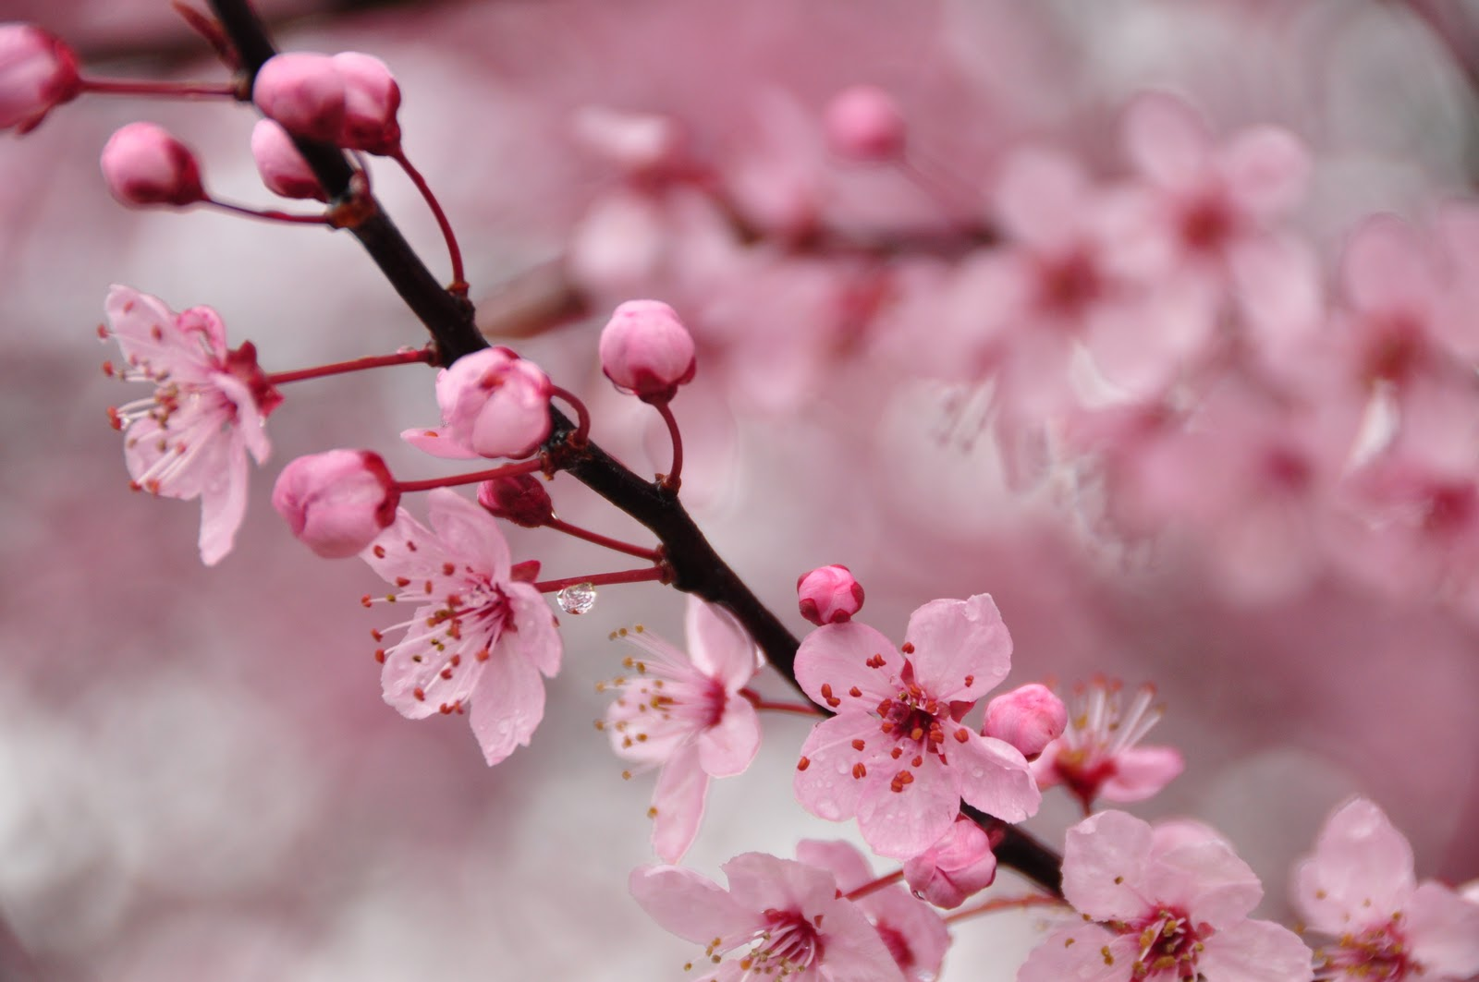
Types of Pollination:
Self-pollination: transfer within a flower or flowers of the same plant
Cross Pollination: transfer between plants
Notes:
Some flowers require cross-pollination for fertilization to take place. For example, a ‘Cortland’ apple flower must be pollinated by a compatible apple cultivar (or even a compatible crabapple) that blooms at the same time, such as ‘Empire.’ Some apples are able to self-pollinate, also called self-fruitful.
Apples, pears, sweet cherries and Japanese plums all require cross-pollination.
Cross-pollination is not essential, but does improve the fruit set for apricots, European plums/prunes, tart cherries, peaches and nectarines.
Some plants (including many weeds) are able to self-pollinate if cross pollination doesn’t take place.

Slide 10
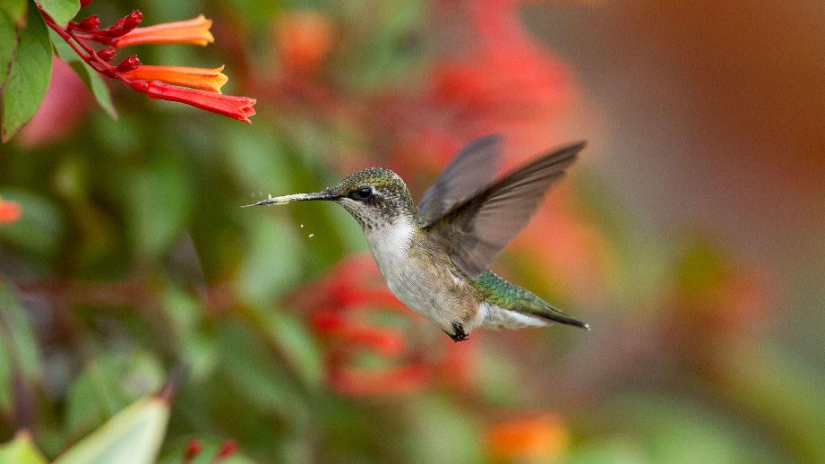
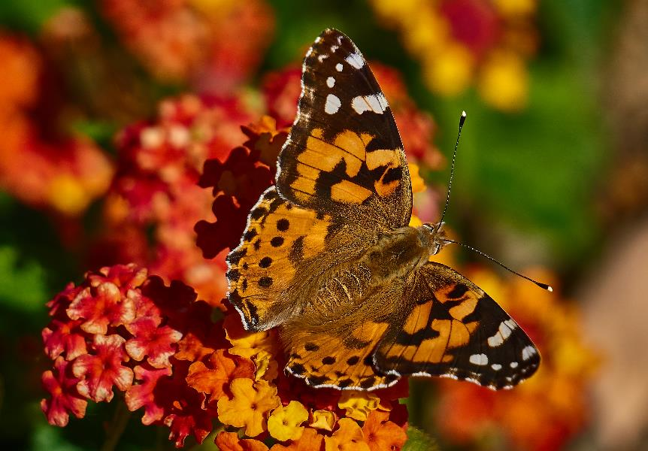
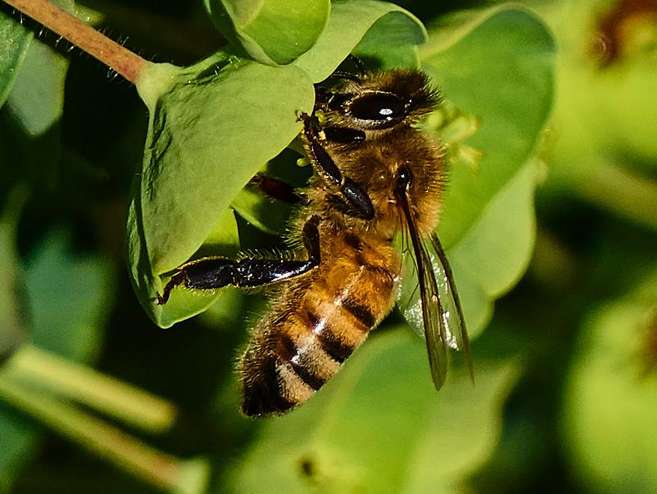
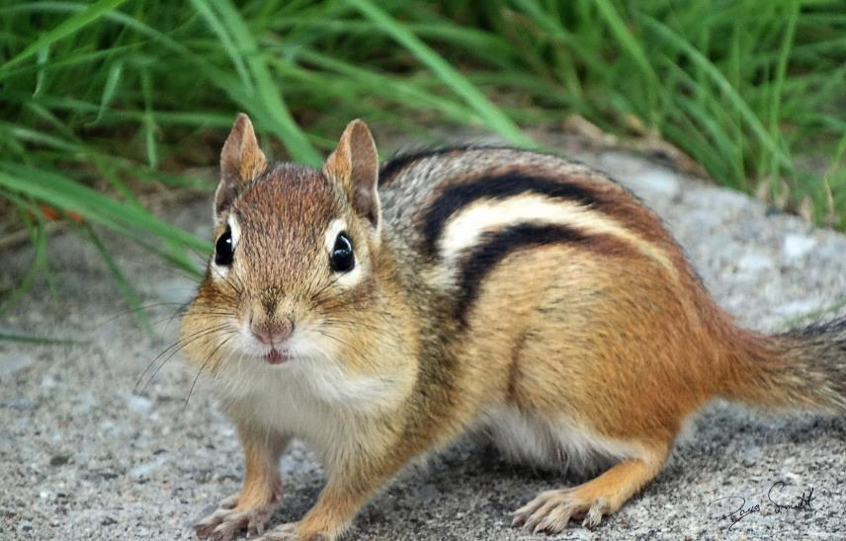
Who Are Pollinators?
Notes:
Many animals serve important roles as pollinators. In some habitats, bats and other small mammals, birds, reptiles and even larger mammals serve as pollinators.
Hummingbirds, fritillary butterfly, chipmunks and honey bees all serve as pollinators.

Slide 11
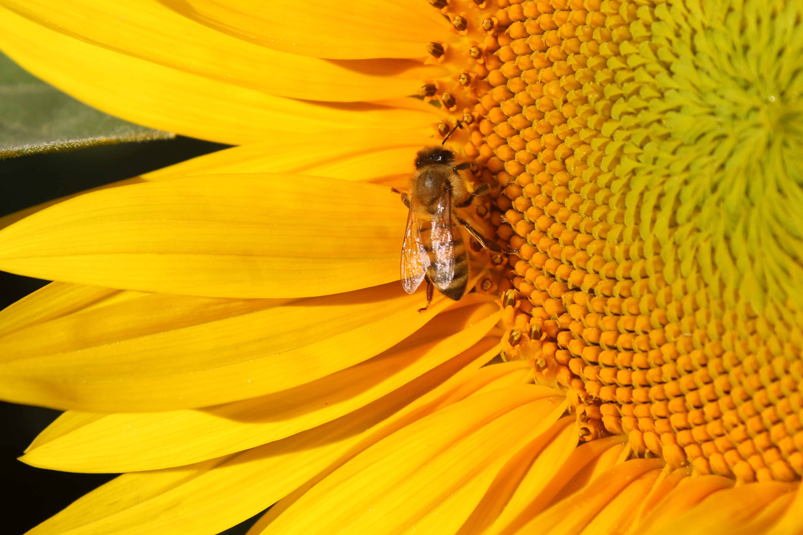
Bees: The Most Important Pollinators
Actively collect and transport pollen
Exhibit flower constancy
Regularly forage in area around nest
Notes:
Bees are the most important pollinators for three reasons:
They actively collect and transport pollen. Many bees will collect pollen and make a pollen ball (also called bee bread) with the pollen and sometimes nectar. For each pollen ball they make the females will lay one egg on top of it – this provision will be the nourishment for the larvae will eat until they pupate and become adults themselves.
2. Exhibit flower constancy. Flower constancy is when a bee forages for pollen, travelling from flower to flower of the same species. This ensures pollination of the flower. For instance, on one foraging trip, a bee will fly from apple blossom to apple blossom to apple blossom. They will NOT go from apple blossom to dandelion to clover to apple blossom. The next foraging trip the same bee may go from clover to clover to clover – thus being selective for the same species of flowers on each foraging trip.
3. Regularly forage in area around the nest. This is great news for most farmers and gardeners. If nesting sites are provided to encourage native bees, or managed colonies of honey bees are kept near crops that need pollination services, bees will forage nearby and help to ensure that crop flowers are pollinated.

Slide 12
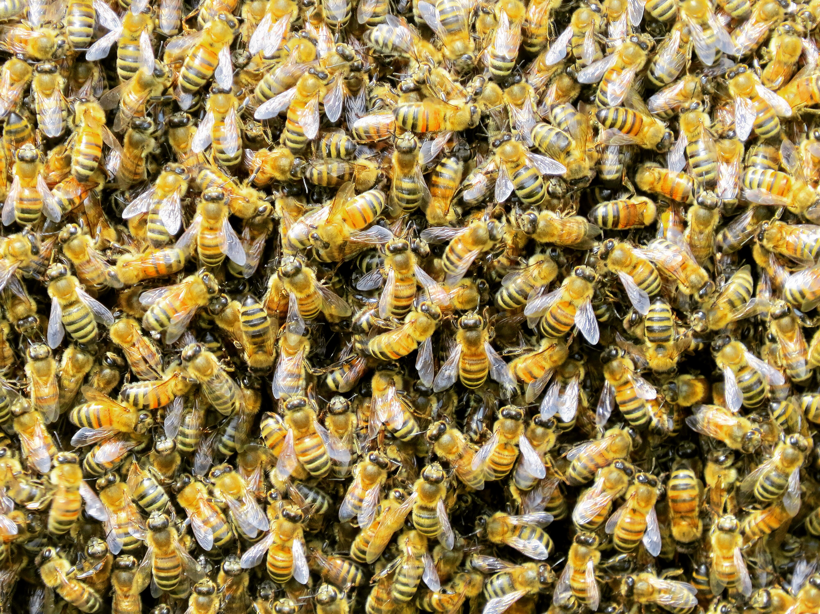
Honey Bees: Non-Native Pollinators
Most crop pollination is done by the European honey bee.
Many crops are reliant on this single pollinator, which is experiencing many problems.
Native bees are efficient pollinators
Notes:
Honeybees are an essential, non-native pollinator insect. They live in colonies that can contain tens of thousands of individual bees.
Honeybees can tell time, distinguish flower shape and color, and communicate with their sisters – abilities that have evolved as a means of increasing honey bees’ efficiency as flower foragers. Managed hives of the European honeybee can take credit for most crop pollination, but there is trouble in relying on a single pollinator. Honeybees face many problems, including mites, diseases, pesticides and habitat loss.

Slide 13
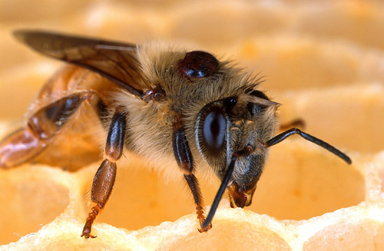
Honey Bees in Decline
Varroa mite
30% decline in managed hives since 2006
Cropland requiring bee pollination has doubled
60% decline in feral colonies
Causes: Diseases, pests, honey prices.
Notes:
One important honeybee pest is the varroa mite, depicted in the photo. Just imagine a mite the size of a dinner plate on your back! These mites weaken bees and vector diseases.
In the US, beekeepers have lost ~30% of their colonies every year since 2006, with total annual losses sometimes reaching as high as 42% (https://ento.psu.edu/pollinators/resources-and-outreach/globally-pollinators-are-in-decline).
Due to pests and pesticides, the feral honeybee population (wild hives) has declined by 70-100%. (https://www.greenpeace.org/usa/wp-content/uploads/2019/08/Bees-In-Decline-Greenpeace.pdf)
Ask participants if anyone has seen a feral beehive in their lives and if so, have they seen one recently? Most of the older generation will remember seeing a feral beehive in a hollowed tree, but very few recall seeing any feral hives recently. Many participants may have seen a bee swarm, but seeing a feral colony is much less common.
Although we have fewer honeybees available due to colony collapse disorder and the decline in the number of beekeepers, we have an increased demand in the amount of acreage of crops that need pollination.

Slide 14
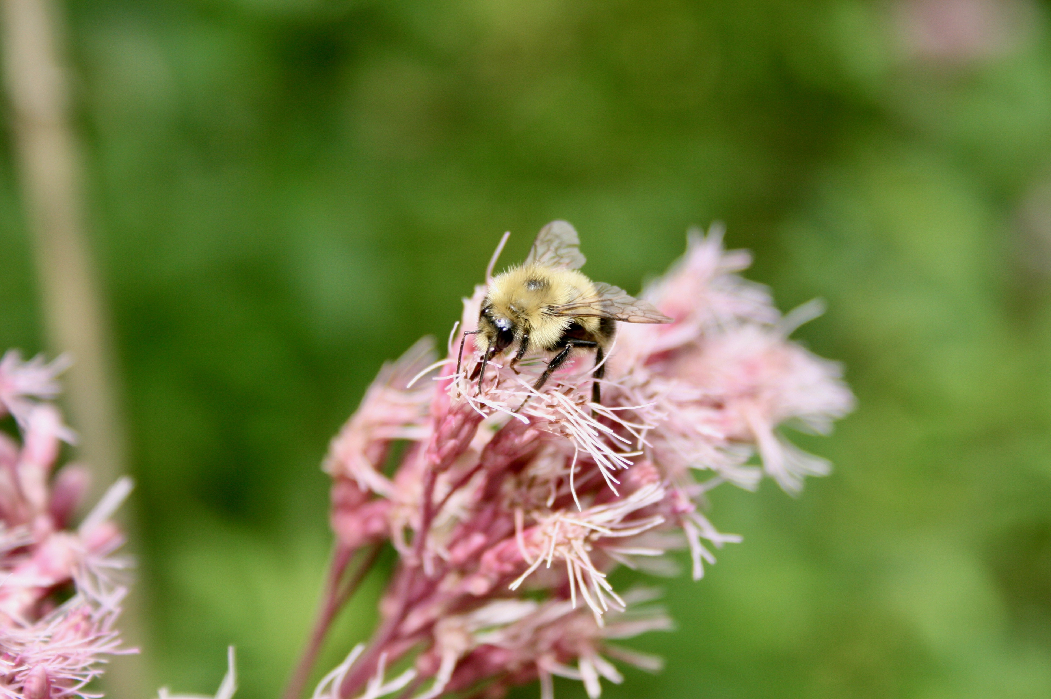
Native Bees as Pollinators
Native bees are efficient pollinators:
Active earlier and later in the day
Collect both pollen and nectar
No rental fees
Can supplement honeybees if honey bees are hard to acquire
Notes:
The value of native bees:
Many native bees are robust in size (such as the bumble bee or carpenter bee) and warm up more quickly in the early mornings and stay out later during cool evenings. Thus these bees will spend significantly more time per day pollinating plants.
Native bees keep honeybees moving. Honeybees tend to linger on flowers, but if they come in contact with a native bee, especially a bee larger than themselves, they will fly to another flower.
Most of these native species are solitary bees, unlike the social honeybee. North America: 4,000+ native species

Slide 15
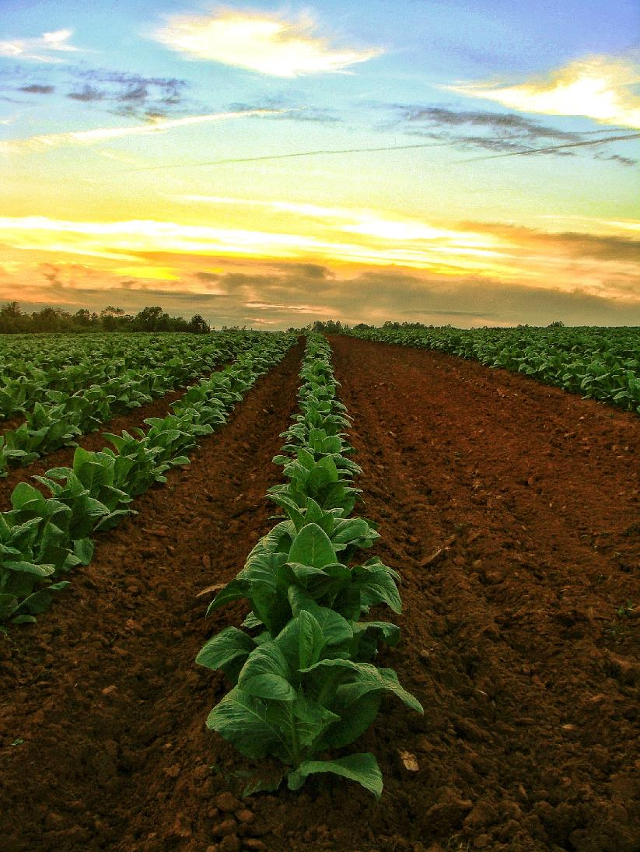
Native Bees in Agriculture
Contribution of native bees to crop pollination:
$3 billion in pollination services per year
80+ bee species recorded visiting berry crops in New England
100+ species documented in Wis. cranberries
100+ species visiting apples in N.Y. and Pa.
50+ species visiting tomato, sunflower or watermelon in Calif.
Notes:
Recently researchers have been studying the diversity and abundance of native bee species found in pollinator dependent crops. Based on their results they have found between 50 – 100+ species of native bee pollinators. Native bees are estimated to provide $3 billion in pollination services per year.
http://extension.missouri.edu/sare/documents/bees.pdf

Slide 16
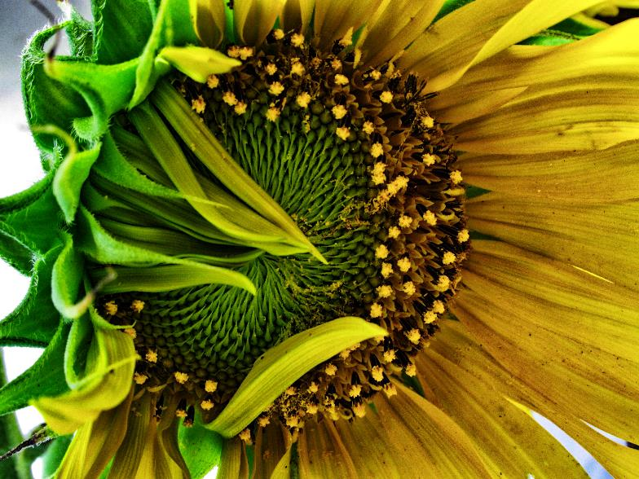
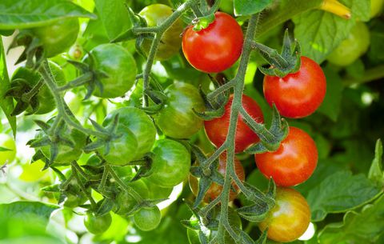
Buzz Pollination by
Native Bees
Example: Cherry Tomatoes
When native bees were present, the production of Sungold cherry tomatoes almost tripled.
Hybrid sunflower production:
When native bees were present the seeds in hybrid sunflower fields more than doubled.
Notes:
Most people don’t think of tomatoes needing pollinators, but with the help of native bees, plants produce significantly more fruit. Honey bees don’t readily visit these flowers because the flowers don’t provide nectar, and the pollen is buried in deep pores inside anthers that need to be shaken (buzz pollinated) to be released.
Bumble bees and several other native species will buzz (vibrate) these flowers. The bee grabs the pollen producing structure of the flower in her jaws and vibrates her wing musculature causing vibrations that dislodge pollen that would have otherwise remained trapped in the flower’s anthers. Some plants, including tomatoes, peppers, and cranberries will not open to release the pollen unless a bee provides the vibration that is equivalent to the “C” note. A bumble bees can grab the tomato flower with its legs and vibrate its thoracic muscles (buzzing) to the tone of “C” thus opening up the flower and releasing the pollen.
Greenleaf, S. S.,and C. Kremen. 2006. Wild bee species increase tomato production and respond differently to surrounding land use in Northern California. Biological Conservation 133:81-87.
In sunflower hybrid seed production, pollen from a male row of sunflowers must be moved by bees to a female (male -sterile) row.
Individual honey bee workers specialize in foraging for either pollen or nectar. They are less efficient on hybrid crops (like sunflowers) where there are separate rows of male and female plants.
Native bees working the sunflowers will bump into honey bees on these crops, causes the honey bees to change course and visit adjacent rows. This increases seed yield. If the native bees were not present, the honey bee would go from one flower to the next down the row of the same sex flower. With native bees present they will actually cross-over to the other sex row – thus being more successful in pollination of the crop.
http://www.xerces.org/wp-content/uploads/2008/10/factsheet_sunflower_pollination.pdf

Slide 17
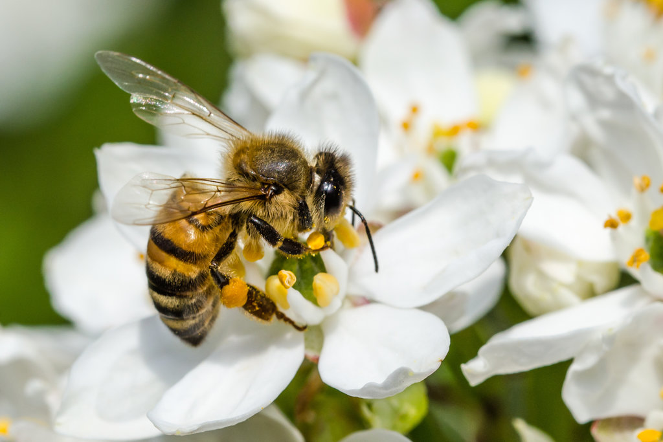
Pollinators in Peril
Threats include:
Habitat loss
Pesticides
Pests
Climate change
Invasive plants
Notes:
17
Pollinators face many threats, including the loss of habitat (nesting and foraging habitat), the effects of pesticides, pests (mites and many diseases), effects of climate change, and pressures from invasive plants.

Slide 18
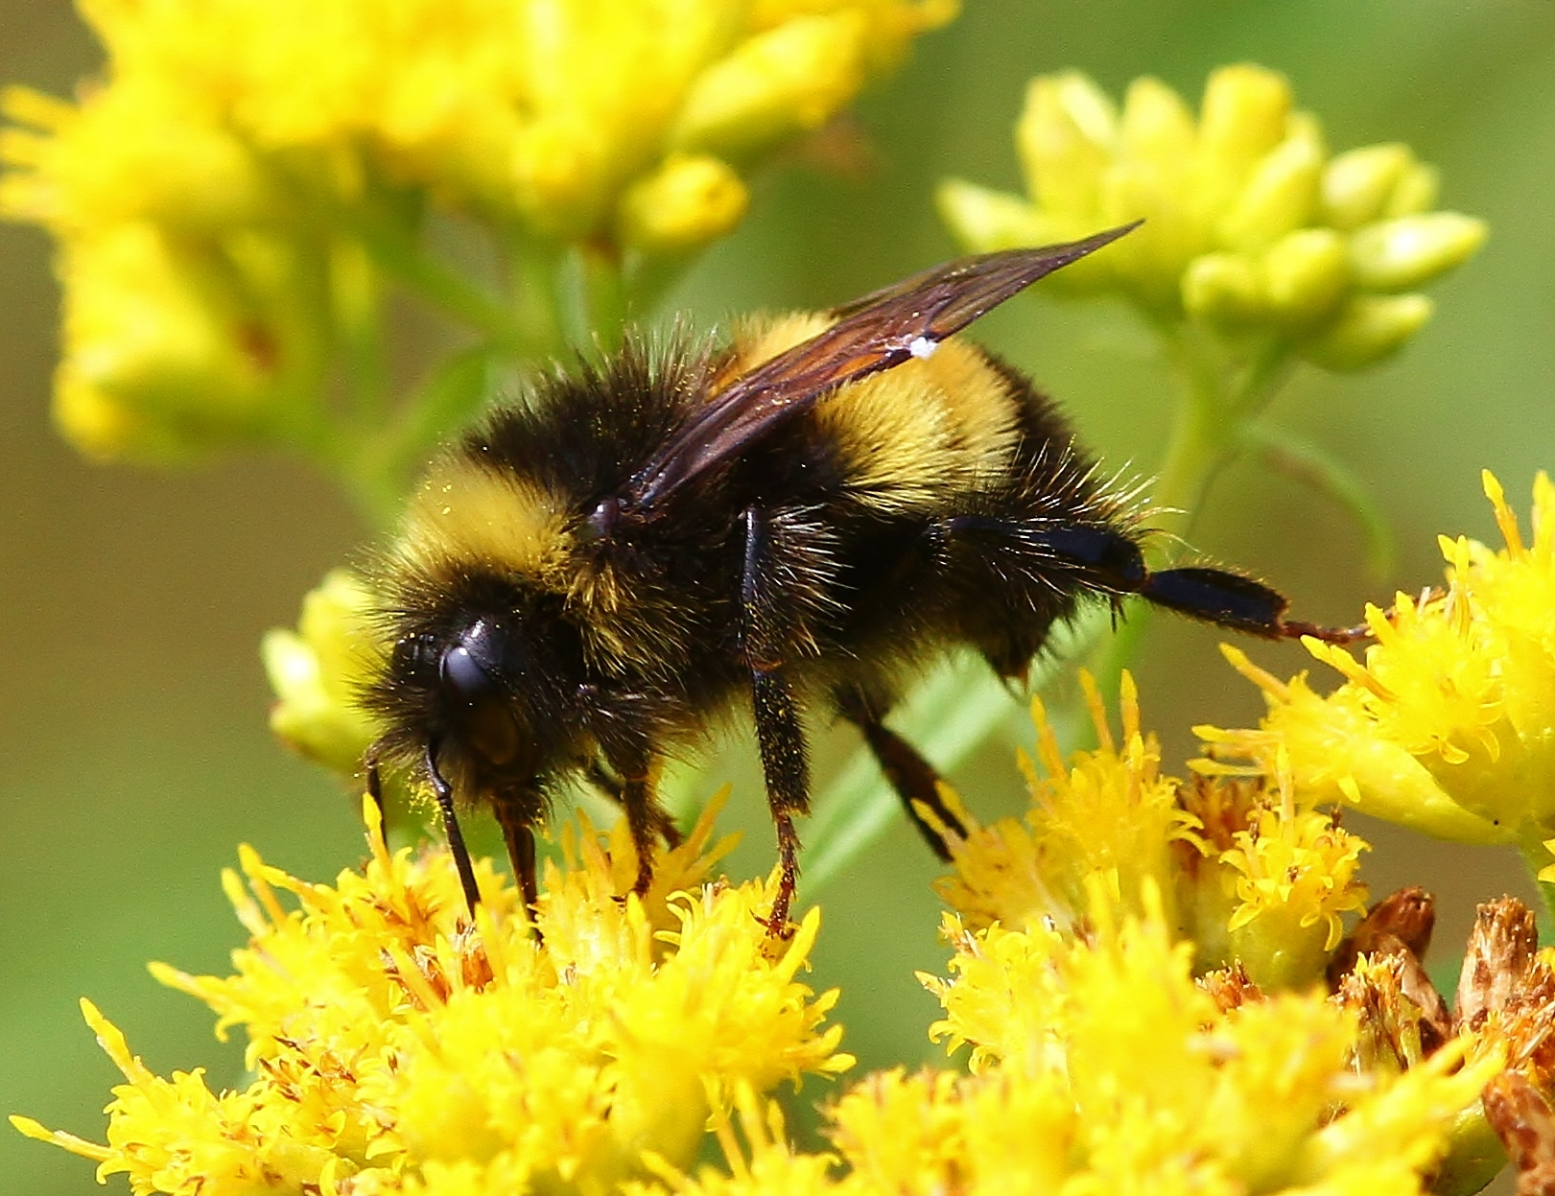
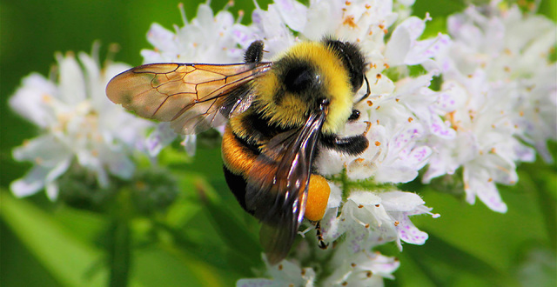
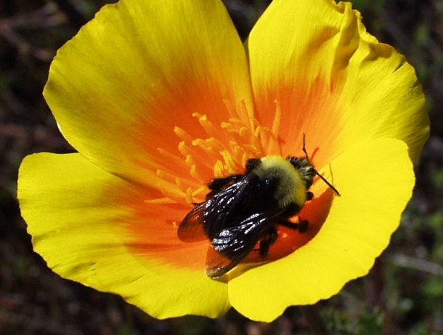
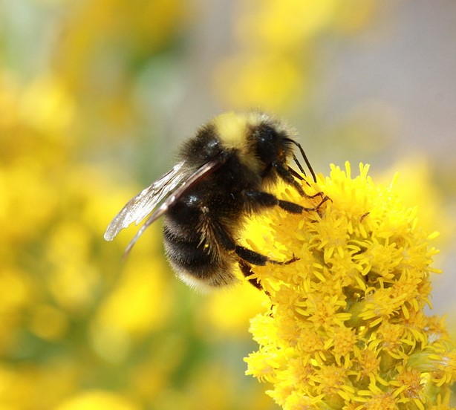
Yellowbanded
Rusty Patched
Four Sister Species of Bumble Bees in Decline
Western
Franklin’s
Notes:
Many of our native bees are also in decline, including several bumble bee species.
Of particular importance are members of the subgenus Bombus. This is a closely related group of “sister species” that range across the country. Once they accounted for some of the most common bees in their range, now they are nearly impossible to find, especially in agricultural areas.
It is suspected that a bee pathogen has spread to wild populations from commercial rearing facilities.
Bombus occidentalis is no longer available for commercial purchase since populations crashed. B. impatiens is now being shipped across the Rockies, beyond its natural range.
B. pensylvanicus is also in decline – (not one of the sister species) and several other Midwest Bombus species also in suspected decline.
https://www.bumblebeeconservation.org/wp-content/uploads/2017/11/Slater-Great-yellow-bumblebee-Factsheet-02.15.pdf
https://www.fws.gov/midwest/endangered/insects/rpbb/factsheetrpbb.html
Cameron et al. 2011. Patterns of widespread decline in North American bumble bees. PNAS
Note the rusty patch of hairs on this bee’s abdomen. This bee has disappeared from most of its historic range.
Keep an eye out for this bee!
Note: without citizen monitors, we wouldn‘t have known that this species still occurs in: MN, MA, and PA.
The basic knowledge of where a rare species presently occurs is a critical first piece of information necessary to conserve that species.

Slide 19
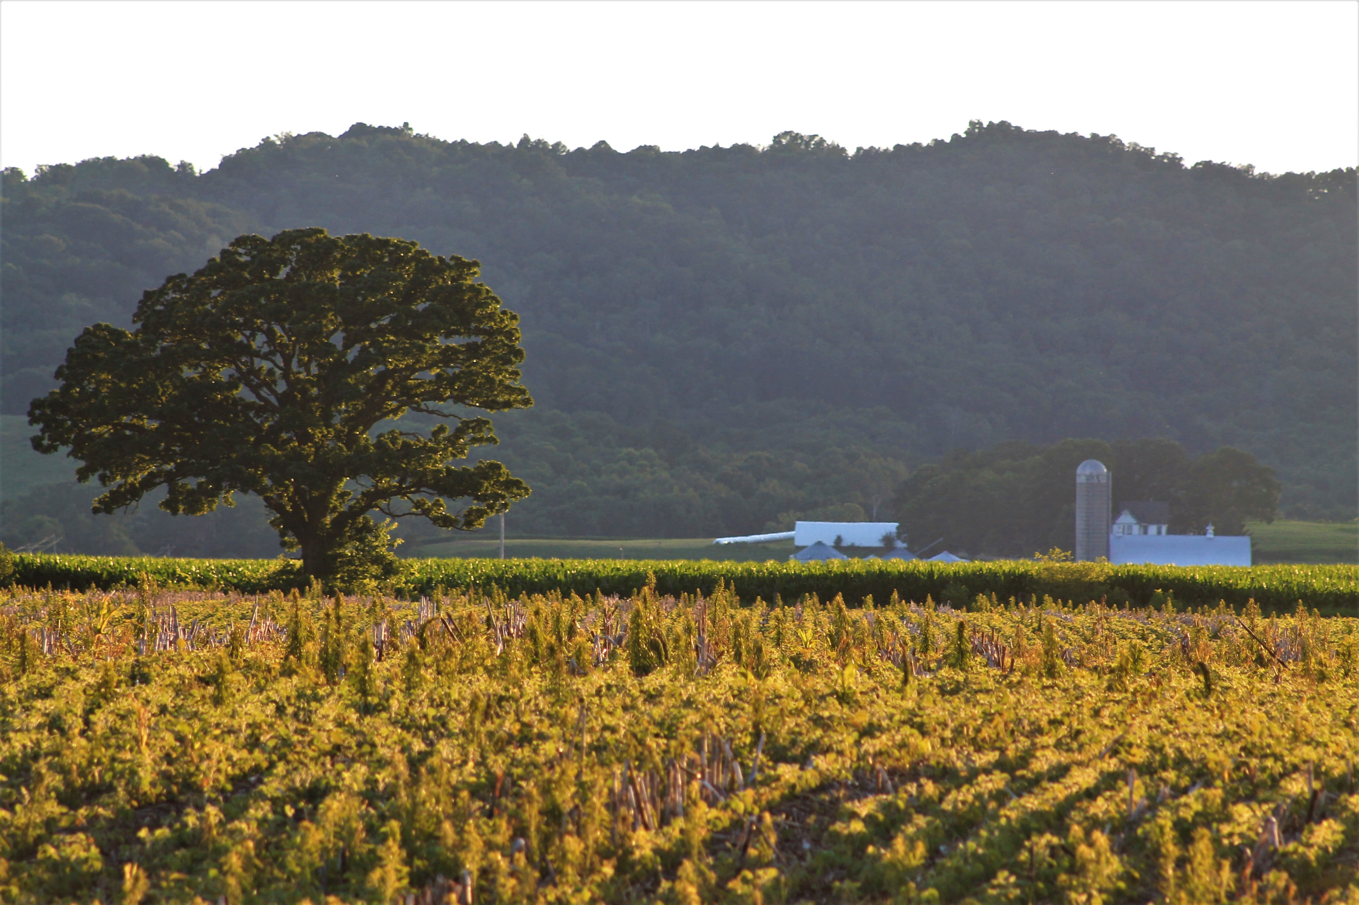
Pollination and Crop Security
Even as bees decline, crop acreage requiring bee pollination grows:
Total global acreage requiring bee pollination rose 300% from 1961 to 2006.
Over the next decade, 5,000-10,000 new acres of Wis. cranberries will require this pollination.
In Calif., 150,000 new acres of almonds are anticipated to need assistance.
Notes:
From 1961 to 2006, the percentage of global cropland requiring bee pollination increased over 300%. It jumped from 18.2% in 1961 to 34.9% in 2006.
To meet the anticipated increases in acreage of bee-pollinated crops over the next decade America will need approximately another half million honey bee hives. With an aging beekeeper population, and declining profit margins, we need honey bees as well as native bees to meet the pollination demands.
¹ Aizen MA, LA Garibaldi, SA Cunningham, AM Klein. 2008. Long-term global trends in crop yield and production reveal no current pollination shortage but increasing pollinator dependency. Current Biology 18:1572-1575.

Slide 20
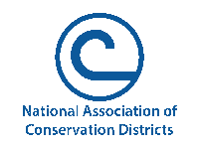
ADD LOCAL, AREA ANDSTATE INFORMATION ON DATES AND OTHER POLLINATORS EVENTS
Notes:
Local info – contact info

